Slide 1
Hiding a text inside an image using steganography

Slide 2
Student details
NAME : VULLI SYAM SIVA SUNDAR
SKILLS BUILD EMAIL ID : syamsivasundar05@gmail.com
COLLEGE NAME :SRK INSTITUTE OF TECHNOLOGY
COLLEGE STATE :ANDHRA PRADESH
DOMAIN OF YOUR INTERNSHIP :IBM SKILLS BUILD CYBER-SECURITY WITH KALI-LINUX
START DATE – END DATE OF INTERNSHIP : 3RD JUNE 2024 – 15TH JULY 2024

Slide 3
PROJECT TITLE : Hiding a text inside an image using steganography
What is Cyber Security?
Cybersecurity is the practice of protecting systems, networks, and programs from digital attacks. These cyberattacks are usually aimed at accessing, changing, or destroying sensitive information; extorting money from users via ransomware
What is steganography?
Steganography is the technique of hiding data within an ordinary, nonsecret file or message to avoid detection; the hidden data is then extracted at its destination. Steganography use can be combined with encryption as an extra step for hiding or protecting data

Slide 4
AGENDA
Project Overview
Who Are The End Users of This Project?
Your Solution and It’s Value Proposition
How did you customize the project and make it your own
Modelling
Results
Links

Slide 5
PROJECT OVERVIEW
OBJECTIVE :
The objective of steganography is to hide a secret message within a cover-media in such a way that others cannot discern the presence of the hidden message.
Image encryption is the process of hiding images from unauthorized access using a secret key.
PURPOSE :
Steganography is the practice of concealing information within another message or physical object to avoid detection.
Steganography can be used to hide virtually any type of digital content, including text, image, video, or audio content.

Slide 6
AIM:
The primary goals of steganography are to achieve these of the following
Robustness
Large embedding capacity
Perceptual transparency
Steganography aims to hide confidential information within innocent carriers such as images, audio, or video files
Steganography has been practiced in various forms for thousands of years to keep communications private.

Slide 7
WHO ARE THE END USERS of this project?
General Users: Everyday individuals who use steganography tools to hide sensitive information within digital media (like images, audio files, or videos) for privacy or security reasons.
Law Enforcement and Intelligence Agencies: These entities may use steganography detection tools to uncover hidden messages or data during investigations.
Military Personnel: Military applications may involve embedding secret messages in images or other media for secure communication.
Security Experts: Cybersecurity professionals might utilize steganography tools to test network defenses or to secure data transmission.

Slide 8
YOUR SOLUTION AND ITS VALUE PROPOSITION
SOLUTION :
My solution for the problem of Cyber Attacks of Stealing Personal Data can be reduced by following some of the methods.
There are many ways to get escape from Cyber Attacks. One of the Way is named as Image Steganography Technique.
Steganography Techniques: Implementation of various steganographic techniques such as LSB(Least Significant Bit) embedding in images, hiding text in audio files through frequency manipulation, or embedding data in the whitespace of text files.
Encryption: Often, steganography is combined with encryption to ensure that the hidden information remains secure even if discovered.
Detection and Analysis Tools: Development of tools to detect steganographic content within media files, which can involve statistical analysis, anomaly detection, or visual inspection techniques.

Slide 9
VALUE PROPOSITION :
Flexibility and Versatility: Can be applied across various digital media types (images, audio, video, text), offering flexibility in how information is concealed and transmitted.
Forensic Applications: Tools for detecting steganographic content can aid forensic investigations, providing insights into hidden communication or digital manipulation.
Research and Development: Supports ongoing research into new techniques and advancements in steganography, contributing to the field of information security and cryptography.

Slide 10
How did you customize the project and make it your own
ALGORITHM SELECTION AND MODIFICATION:
The choice of steganographic algorithm was carefully considered based on its suitability for embedding data within various media types.
USER INTERFACE DESIGN:
The user interface (UI) was customized to ensure ease of use and intuitive interaction.
INTEGRATION OF ADDITIONAL FEATURES:
Additional functionalities were integrated to extend the utility of the application beyond basic steganographic operations.

Slide 11
TESTING AND VALIDATION PROCEDURES:
Rigorous testing procedures were customized to validate the accuracy and reliability of the steganographic techniques employed.
DOCUMENTATION AND REPORTING:
Detailed documentation was customized to provide comprehensive insights into the project’s development process.

Slide 12
MODELLING
Data Model: This involves defining how data will be represented and manipulated within the steganography system. It includes decisions on data formats (text, binary, etc.), encoding schemes, and how data will be structured for embedding and extraction.
Embedding Model: This specifies the technique or algorithm used to embed hidden data into a cover media (such as an image or audio file). Modeling here invdves determining how to modify the carrier file to embed the hidden information while minimizing perceptible changes and maintaining cover media integrity.
Extraction Model: This defines the method for extracting hidden data from the carrier media. Modeling the extraction process ensures that the embedded information can be accurately retrieved, even after potential alterations to the carrier file.

Slide 13


Results
NORMAL IMAGE
Consider Any normal image from your PC, and use the image for the encryption as the cover image.
The cover image is used as a secured layer over the hidden text.
Before encryption it is just a normal image without any hidden data.
ENCRYPTED IMAGE
After the encryption , the image we obtained is the encrypted image which is represented as below figure
It acts a protective layer from cyber attacks to steal the information.
After the encryption the resulted encrypted image has a hidden data in it.

Slide 14
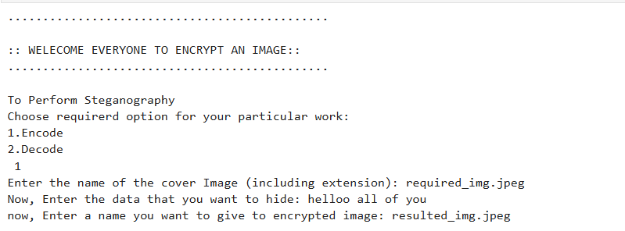
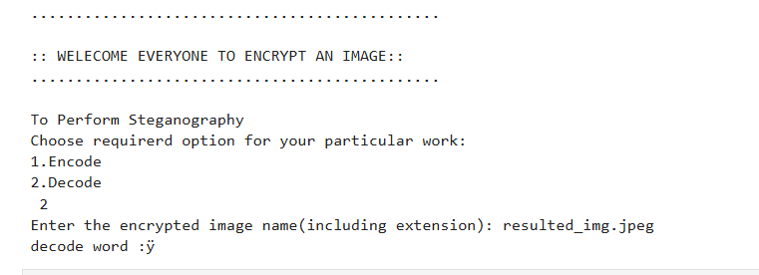
ENCRYPTION :
Firstly ,the encryption process takes place.
To start the encryption we have to use the security key.
Then the text we required to hide should be entered.
Finally the data is securely hidden in the required image.
DECRYPTION :
After the image encryption, its time to decryption on the other side.
To start it we have to enter the same common security key.
Then a logic number also has to be entered into it.
Finally the data is which was securely hidden will be displayed out.

Slide 15
links
GITHUB LINK :
https://github.com/syamsivasundar05/Hiding-A-Text-Inside-An-Image-Using-Steganography

